Slide 1
Baby Birth Weight Analysis
By: Chetan Bhanushali

Slide 2
About Project
My project is about analyzing the factors that affect baby birth weights. Every family wants that the new member coming to the family has good weight. But what are the factors that greatly influence the baby birth weight? How significant they are? Are there any relation between these factors? This presentation will answer all these questions and of course the questions that you might have.
But first let’s understand the dataset.

Slide 3
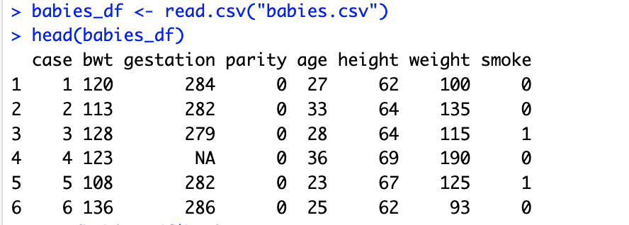
The Dataset
My dataset contains 7 columns and 1236 rows.
Columns:
Birth weight (bwt)
Gestation period (gestation)
Parity (not useful)
Mothers age (age)
Mothers height (height)
Mothers weight (weight)
Is smoker? (smoke)
All columns have continuous values except for smoke column which has binary values(1,0)
Since my data had NA values, I had to clean the data set and select 1000 samples from it.

Slide 4
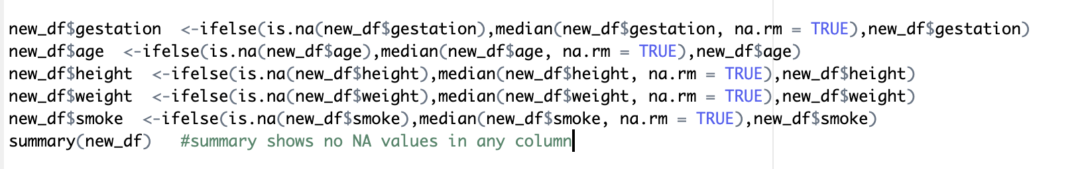
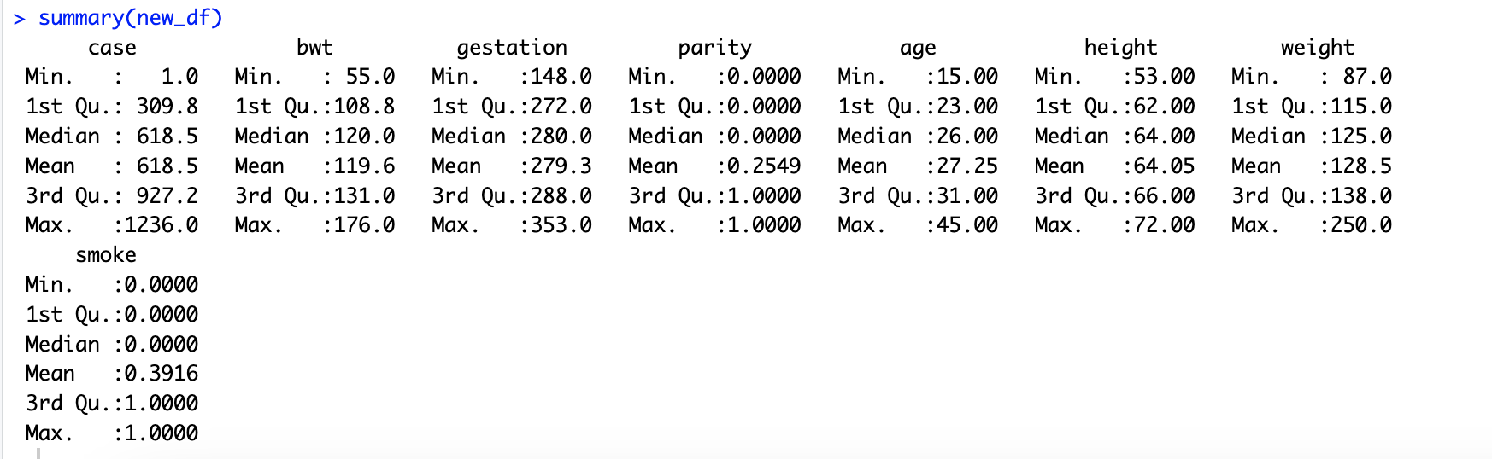
The Dataset
I replace NA values with median values.
We can check if any columns have NA values and get the count by using summary() method.

Slide 5
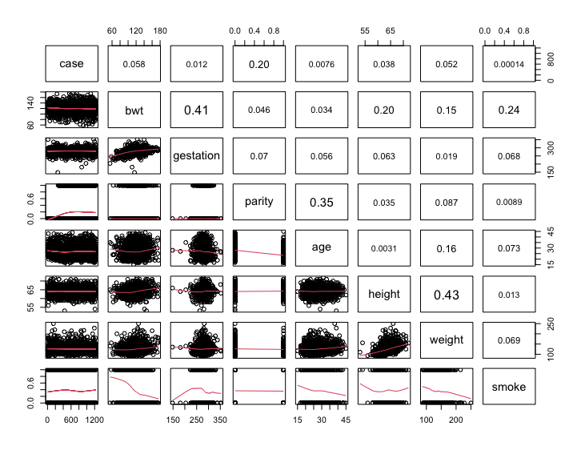
Research Scenario
Is there a linear relation between birth weight and gestation?
Is age and height of the mother a significant predictor of the baby's birth weight?
What is the effect of height after controlling for age?
What is the effect of age after controlling for height?
Does birth weight depend on smoking habits?

Slide 6
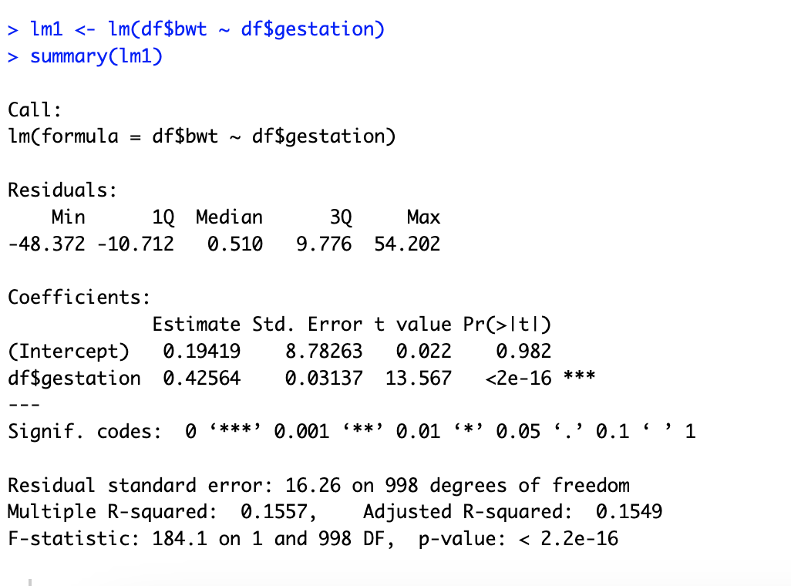
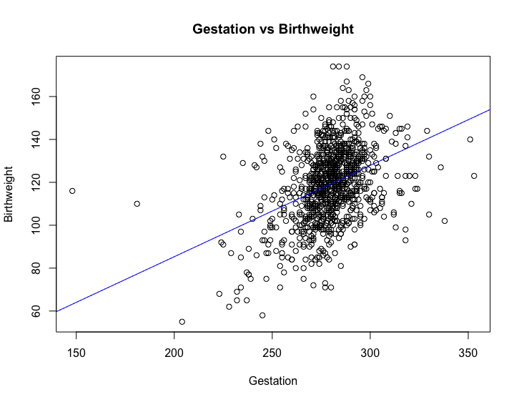
Research Scenario
1. Is there a linear relation between birth weight and gestation?
To find out the strength and nature of relation between bwt and gestation we will perform Simple Linear Regression followed by hypothesis testing. Hypothesis testing is used here to confirm if our beta coefficients are significant in a linear regression model.

Slide 7
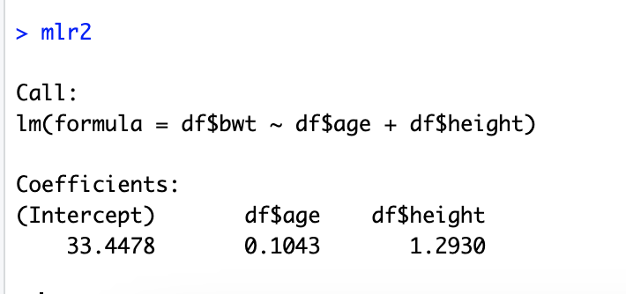
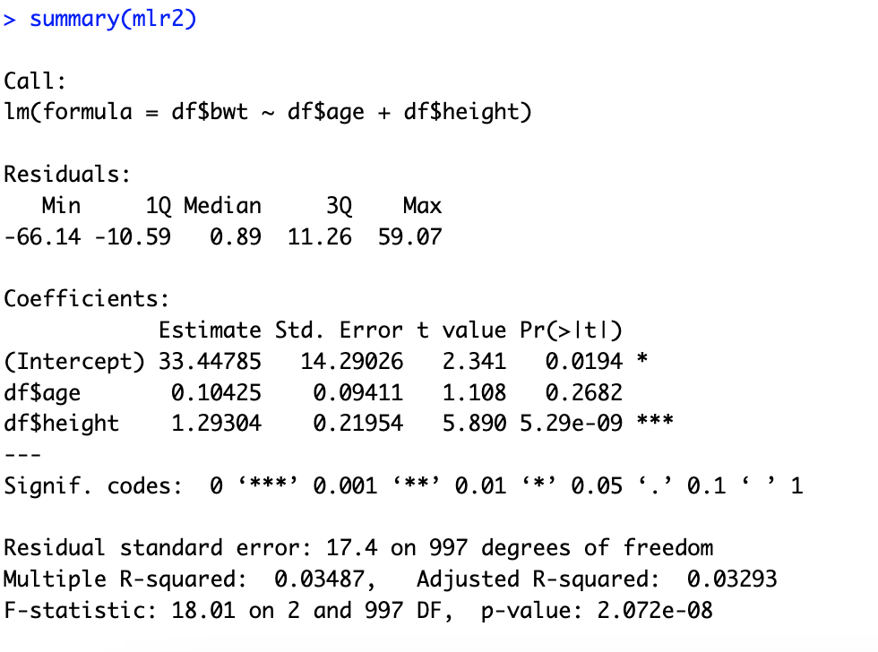
Research Scenario
PASS
2. Is the age and height of the mother a significant predictor of the baby's birth weight?
To answer this question we will use Multiple Linear Regression and hypothesis testing.

Slide 8
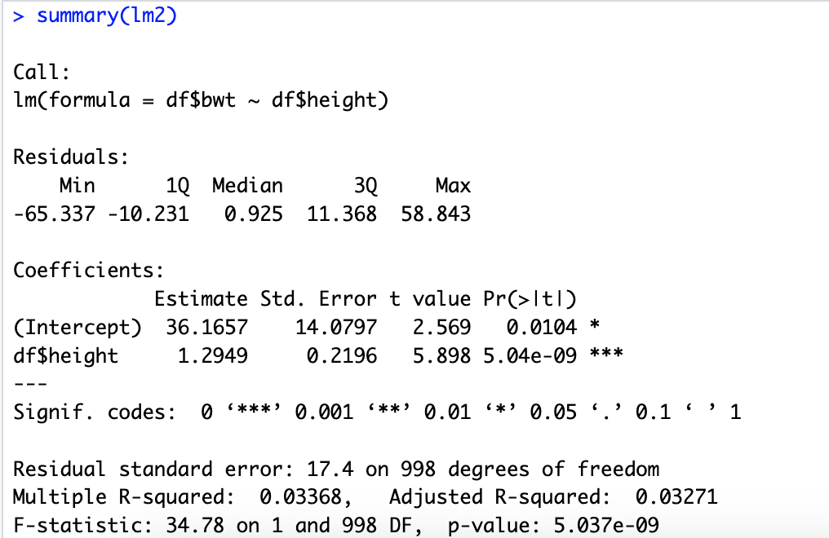
Research Scenario
PASS
3. What is the effect of height after controlling for age?
To answer this question we will run t-test with hypothesis testing.

Slide 9
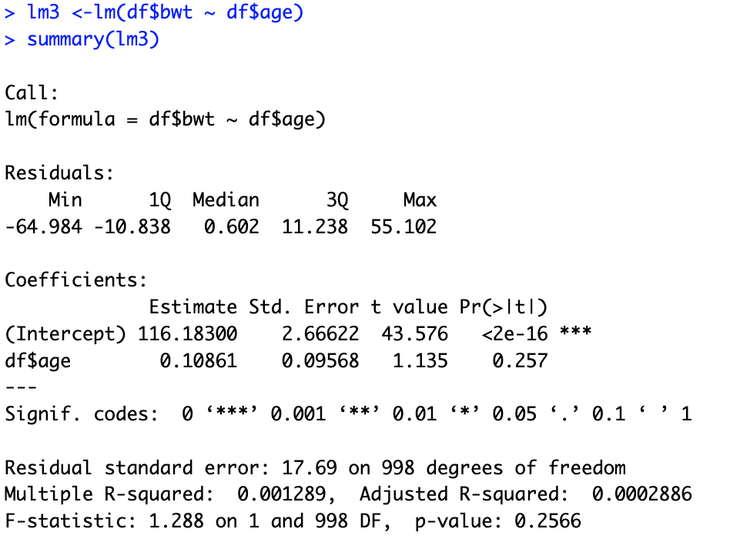
Research Scenario
FAIL
What is the effect of age after controlling for height?
To answer this question we will run t-test with hypothesis testing.

Slide 10
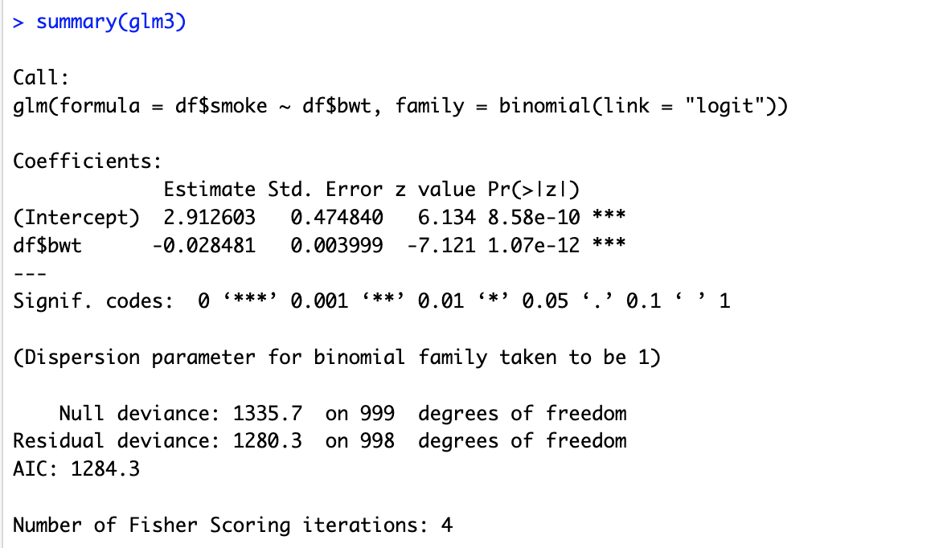
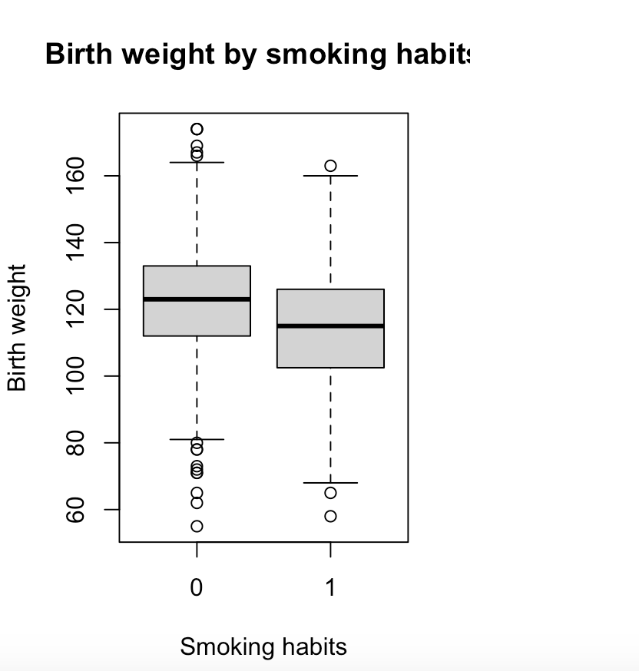
Research Scenario
Does birth weight depend on smoking habits?
We will use Logistic regression to answer this question. This is because the smoke column is a binary column with values 0 and 1.

Slide 11
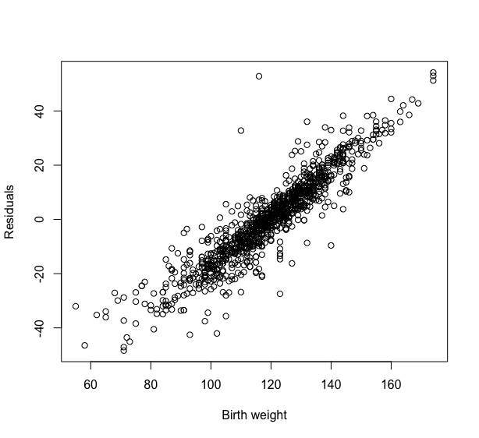
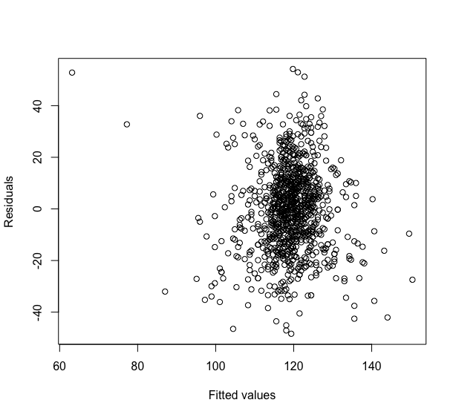
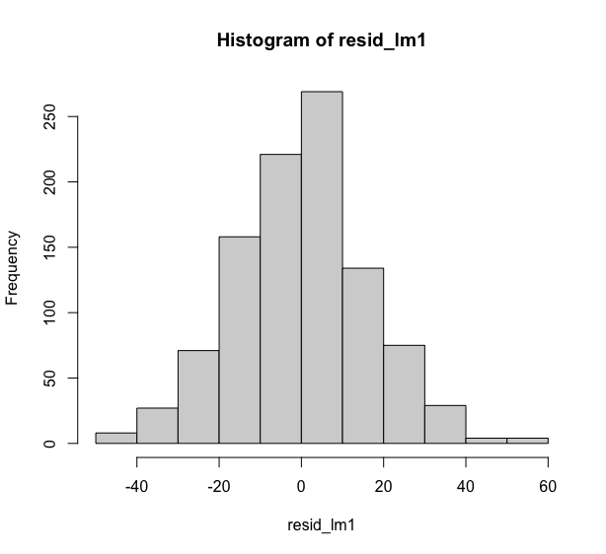
Assumptions
Let’s check if our simple linear model, lm1 satisfies all assumptions.
Linearity proved
Constant variance proved
Normally distributed proved

Slide 12
Conclusion
In conclusion, we found that the birthweight of babies is directly correlated to gestational age. The correlation graph showed positive association which means with increase in gestational age, baby birth weight also increases.
Next, we saw how multiple variables have an effect on birthweight. Weight and height are also directly associated with birth weight. But we noticed that height and weight themselves are highly correlated with each other. This might have a negative effect on our observation because of multicollinearity . Hence we decided to consider only one variable out of weight and height.
Age and height together proved significant factors of birthweight. But when we tested the hypothesis for individual parameters, we noticed that age is not a significant parameter alone by itself whereas height is. This means baby birth weight is independent of age of mother alone but when considering along with height it shows high significance.
Smoking habits does have effect on baby birth weight. It was noticed that low birth weight is a cause of smoking habit.

Slide 13
Thank You for listening

